Slide 1
AVR Timer/Counter
Dr.Sreejith Rajan

Slide 2
AVR Timer/Counter
Generating precise time delays
Counting external events or pulses
Producing PWM signals (for motor and LED control)
Measuring time intervals
Generating periodic interrupts for task scheduling

Slide 3
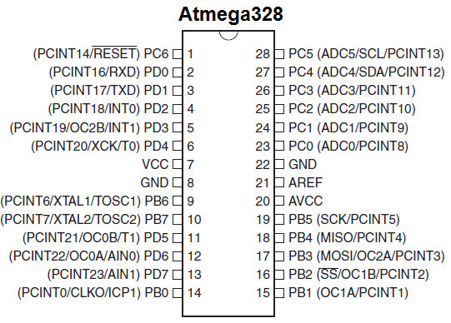
Basics
Timer0 (Counter)– 8 Bit(ie. 0-255 or 00-FF).
Timer1(Counter) – 16 Bit(0000-FFFF).
Timer2 (Not A Counter)– 8 Bit.

Slide 4
Timer Overview
0
1

Slide 5
Let’s See an example
Let’s assume the oscillator frequency is 1MHz. And the counter register is at 00.
f= 1MHz ➔ T_{period} = 1/f = 1µs.
That means the counter register gets pulses every 1µs. ie. The register value increases by 1 in every 1µs.
0
1

Slide 6
Cool…
Then how can I get a delay of 200µs using this feature?
There are two methods.
0
1

Slide 7
Method 1-Normal
Method 1: Subtract 200 from the maximum value of the counter register.
Save the resultant value in the counter register.
Start counting from there and look for the flag set.
When the overflow flag is set. We get the 200 µs delay
0
1

Slide 8
Method 2- CTC
CTC- Clear Timer on Compare Match
Save 200 in a register.
Start the counter register from 0.
Compare the counter register value with that register.
Set a flag when both registers are equal. And stop.
We got a 200 µs delay!
0
1

Slide 9
Concept of Pre scalar
Assume a situation where you need an 800µs delay
Ie. 4 times what you got before with a 1 MHz clock frequency.
An interesting way to do this is to divide your clock frequency by a scalar and give that value to the counter register
0
1

Slide 10
Let’s See in Detail
Assume the Clock frequency is 1 MHz and the prescaler is 4.
Now the frequency received by the counter register
f_{new} = f/4 = 1MHz/4 = 250kHz.
T_{new} = 1/fnew = 4µs
That means, now the count register increases the count by one in each 4µs
1

Slide 11
Register set of Timer/Counter
Timer/Counter Register(TCNTn)
Output Compare Register(OCRn)
Timer Counter Control Register(TCCRn)
Timer Interrupt Flag Register(TIFR)

Slide 12
Timer/Counter Register(TCNTn)
TCNT0, TCNT1 and TCNT2 : 0 on reset. Counts up on pulses and reaches maximum value( 255 for 8 bit timers. And 65,535 for 16 bit timer). The TOVn flag is set when TCNT overflows.

Slide 13
Output Compare Register(OCRn)
OCR0, OCR1 and OCR2: Used to store a preset value. Used Only in CTC mode
OCR1A and OCR1B: Two 8-bit registers since Timer 1 is a 16-bit register.
OCFn Flag is set when TCNTn value and OCRn value are equal.

Slide 14
Timer Counter Control Register
TCCRn: Used to set various modes of operation of the timer.
TCCR0,TCCR2 for timer 0 and 2.
TCCR1A and TCCR1B for timer 1

Slide 15
Timer Interrupt Flag Register(TIFR)
TIFR: 8-bit register containing the flags of different timers.

Slide 16
THANK YOU

